Slide 1
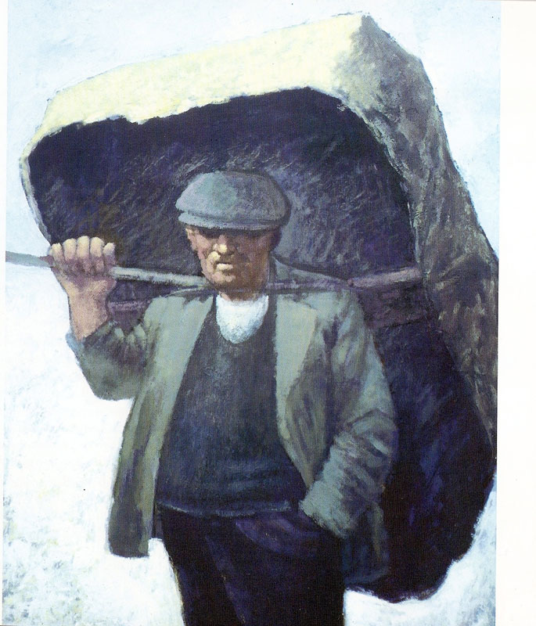
Used with kind permission of Aneurin Jones
A series of interactive lessons and instructions for teachers to create a art project:
Years 5 a 6
Lesson 1
Workers and the workhouse during Victorian Times
Next page

Slide 2
Project Introduction
You are going to study work by the Welsh artists
Aneurin Jones and Nicholas Evans
so that you will be inspired to create a piece of imaginative work based on life in the workhouse during Victorian Times.
Previous page
Next page

Slide 3
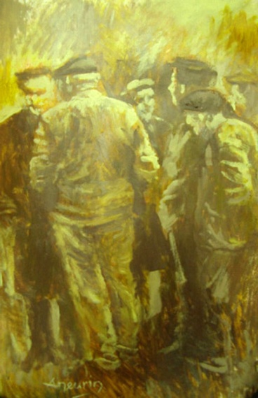
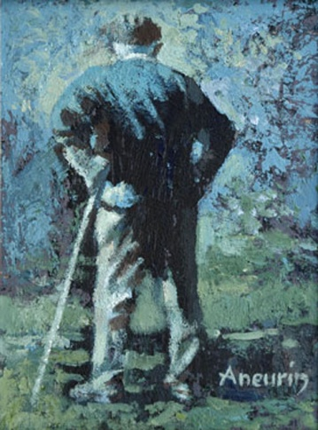
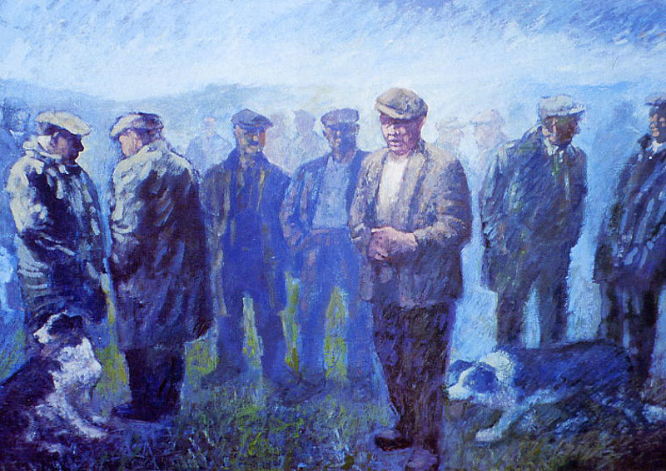
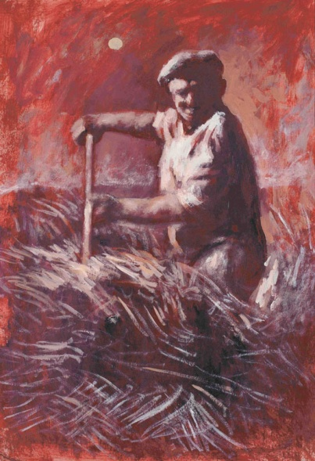
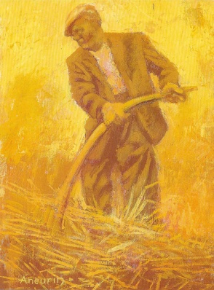
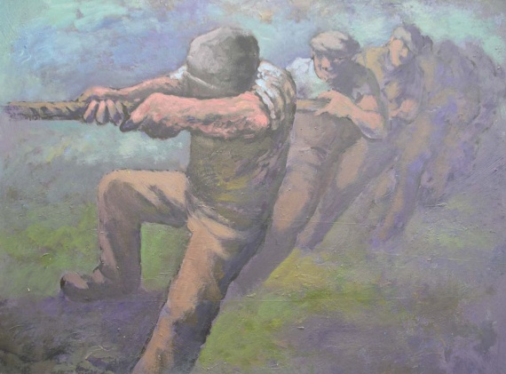
Aneurin Jones Pictures
Used with kind permission of Aneurin Jones
Sir Gar
Cwm Wysg
Cymeriadau
Aneurin Jones
website
Click here to read the artists biography.
Lleuad Fedi
Tug o’ war
Previous page
Next page

Slide 4
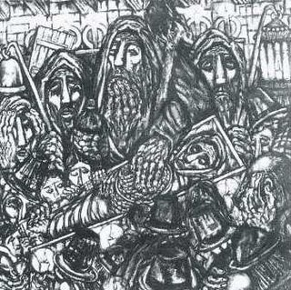
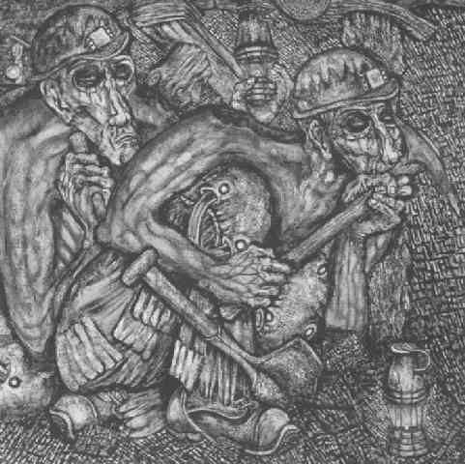
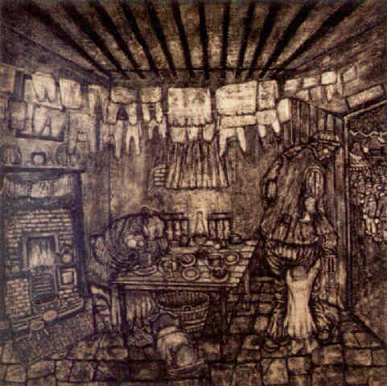
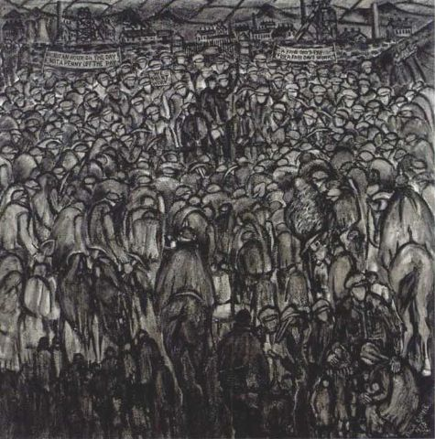
Nicholas Evans Pictures
Used with kind permission of Nicholas Evans
The sin eater, (no date)
Dreams very often come true, (dim dyddiad)
Down the Pit, 1976
Click here to read
the artists biography.
Nicholas Evans
website
Miner’s strike- A fair day’s pay for a fair day’s work, 1978
Previous page
Next page

Slide 5
By the end of the project your teacher will be looking for work of a standard that will include the following…..
A collection of sketches of the workers stances during the Industrial era/age.
Show understanding of the different emotions that colour and tone can convey.
Use human models to create a series of 3D work by using different techniques and clay equipment.
Create an imaginative image of life in the workhouse during Victorian Times.
Previous page
Next page

Slide 6
So that we can discuss work created by artists successfully, we need to understand the following vocabulary. Try and define the meaning of the following words and remember to use a dictionary if required.
picture
charcoal
equipment
biography
artists
inspire
shape
Vocabulary
mood
observe
workshop
atmosphere
Time period
technique
palette
tone
series
Previous page

Slide 7
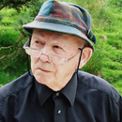
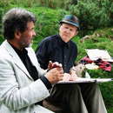
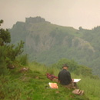
Aneurin Jones Biography
Aneurin Jones was born to a farmer in the rural locality of Cwm Wysg, which is on the border between the old counties of Carmarthenshire and Brecon. He received his higher education at Swansea Art College between 1950 and 1955, where he studied fine art. After graduating he spent two years with Celtic Studios, designing stained glass windows for churches in Britain, Canada and the United States. He was the head of the Art Department in Ysgol y Preseli, Crymych when it opened in September 1958 until July 1986.
The artist has been a regular exhibitor at the National Eisteddfod, and at Machynlleth National Eisteddfod he was awarded the major prize in the open competition for artists born or living in Wales
Aneurin acknowledges that the essence of his work emanates from the formative years he spent in the mythical land of his birth.
"Although I moved away in the pursuit of education etc., a part of me never left the area at all. It was its landscape and its people that moulded me in effect, it was their stories which fired my early imagination and their humanity which formed my outlook on life. The physical shape and pattern of these people excite me creatively and this is the drive which results in my paintings.
Previous page
Back to artists work
Next page

Slide 8
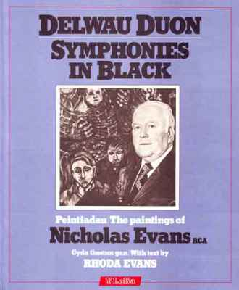
The Welsh artist Nicholas Evans was unusual compared to other artists of his time as he was in his late 60’s when he started painting. His work was not displayed to the public until 1978, when the artist was 71 years of age. Nicholas Evans was previously a train driver. Nicholas Evans was born in Aberdare on the 10th January 1907. He married Annie Lambert in 1928 and they had three children. Nicholas Evans died in 2004 and his wife died in 1997.
Painters such as Josef Herman and Will Roberts emphasised the heroism of colliers, however Nicholas Evans images were totally opposite. He showed them as victims, their spectral faces ravaged by physical toil and the harsh conditions of working underground. Nicholas Evans had personal experience of this industry and life as he once worked as a miner when he was a young man.
His talent for sketching was discovered by one of his teachers whilst at primary school. He was given a new pencil by this particular teacher who also gave him much support to develop his talent.
Nicholas Evans Biography
Used with kind permission of Y Lolfa
Nicholas Evans very much enjoyed the time that he spent sketching however he had to give up this hobby when he could not afford to buy paper. Nicholas Evans re introduced himself to the technique of sketching when he was in his 60’s once he had retired from work. Before long his house in Abernant was full of paintings and sketches using his own personal style. He used black, grey and white to convey emotion and the seriousness of a collier’s situation.
Previous page
Back to artists work

